Slide 2
Early Optimism
“Machines will be capable, within twenty years, of doing any work a man can do.”
–Herbert Simon, 1952

Slide 3
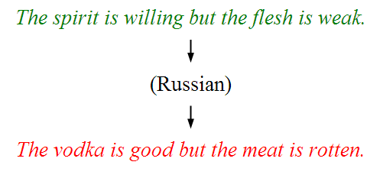
Underwhelming Results

Slide 4
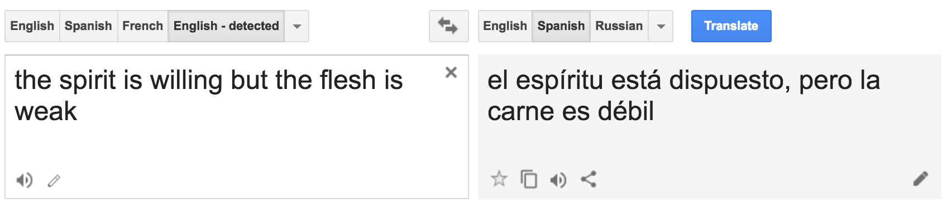
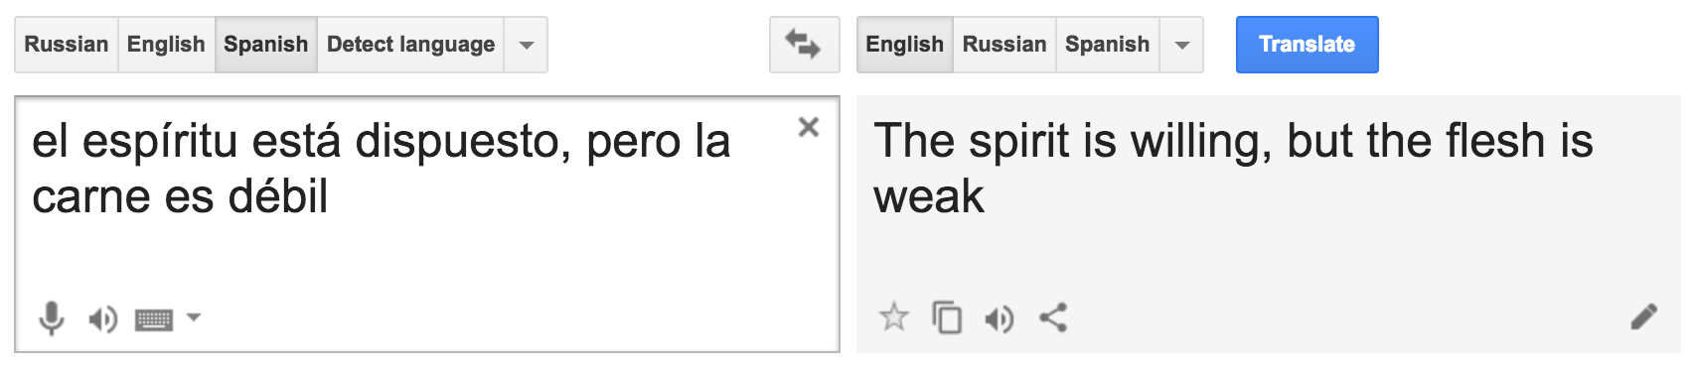
And Now?
English to Spanish
Spanish to English

Slide 5
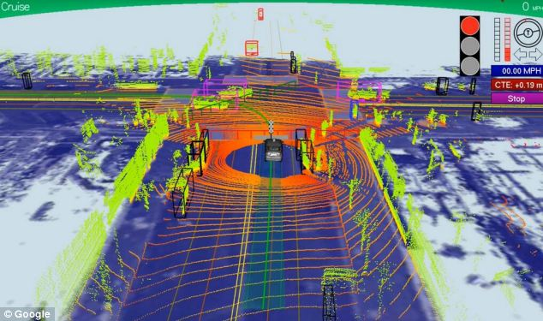

Slide 6


